Slide 1
COMP 3500 Introduction to Operating Systems Project 4 – Processes and System Calls Part 2: Introduction to System Calls
Dr. Xiao Qin
Auburn University http://www.eng.auburn.edu/~xqin
xqin@auburn.edu
Notes:
Fall’17: 27a-deadlock detection: 20 Minutes
27b: slides 1-10 30 Minutes
Cont. from 27b Slides 11
Fall’17 Scheduled is changed: project 4-2, 4-3 is scheduled from week 10/11 to week 9.

Slide 2
runprogram.c
~/cs161/src/kern/userprog/runprogram.c
Function: runprogram()
This is sample code for fork() and execv()
Let’s trace runprogram()

Slide 3
Trace runprogram()
main/menu.c: cmd_disptach()
through cmdtable ‘p’ cmd_prog
cmd_prog()
cmd_shell()
main/menu.c: common_prog()
main/menu.c: cmd_progthread()
userprog/runprogram.c: runprogram()
Notes:
you have to implement the interface between user-mode programs ("userland") and the kernel. You will be provided part of the code needed for this assignment, and you are required to design and implement the missing pieces. Your job also includes implementation of the subsystem that keeps track of the multiple tasks you will have in the future. Importantly, you need to design data structures for "process" (Hint: look at kernel include files of your favorite operating system for suggestions,

Slide 4
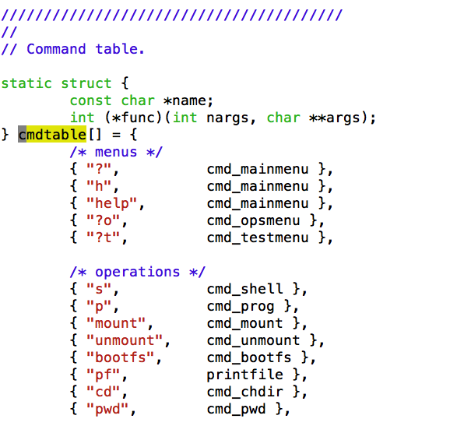
An Example of Separating Policies from Mechanisms.

Slide 5
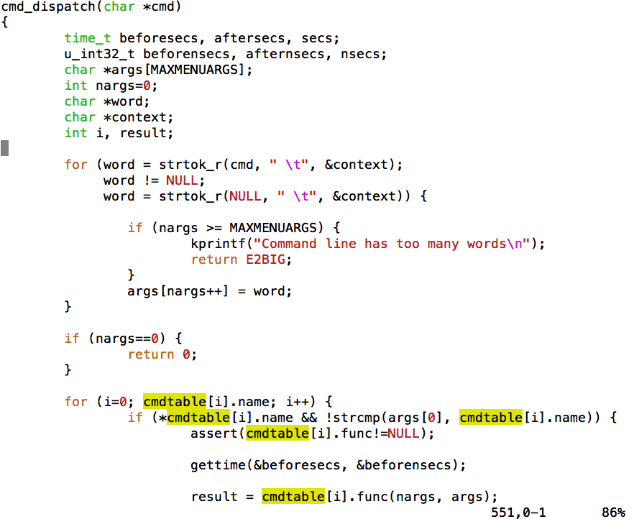
Exercise 1. (1.1) What does word represent in this command-line parser?
(1.2) (Plickers) Which variable holds a command?
(1.3) (Plickers) Which line invokes the command function?

Slide 6
Exercise 2: How to implement runprogram()?
userprog/runprogram.c: runprogram()
vfs_open(…, &v) in
kern/fs/vfs/vfspath.c
as_create(), as_activate(), as_define_stack(&stackptr) in
kern/arch/mips/mips/dumbvm.c
(2.1) What is the first thing to do when an OS runs a program? (Hint: where is the program stored?)
load_elf(v, &entrypoint)
In kern/userprog/load_elf.c
md_usermode(…, stackptr, entrypoint)
In kern/arch/mips/mips/trap.c
(2.2) Can you figure out how the data are flowed from one module into another?
mips_usermode(&tf) in trap.c
Notes:
as: address space
tf: trap frame
elf: Executable and Linkable Format
Kern/arch/mips/mips are hardware related code.
md_usermode: create a trap frame to be executed by the hardware.
Data flow: from &v to v; from &entrypoint to entrypoint.

Slide 7
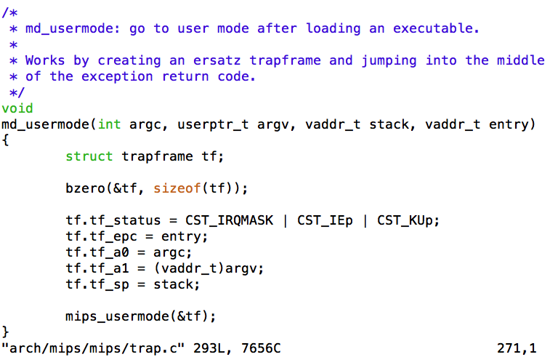
md_usermode()
Notes:
as: address space

Slide 8
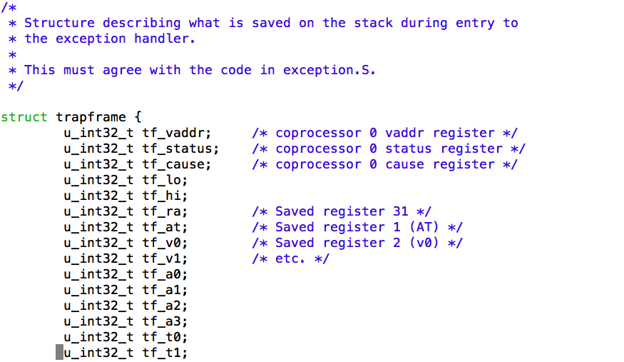
Data Structure: trapframe
Notes:
37 Registers
Size = 37 * 4 bytes.

Slide 9
System Call Using the trap Instruction
…
fork();
…
Trap Table
Kernel
fork() {
…
trap N_SYS_FORK()
…
}
sys_fork()
sys_fork() {
/* system function */
…
return;
}
Slide courtesy of Dr. Gary Nutt

Slide 10
A Thread Performing a System Call
User Space
Kernel Space
Thread
fork();
sys_fork() {
}
Slide courtesy of Dr. Gary Nutt

Slide 11
System Call: sys_reboot()
main/menu.c: cmd_disptach()
through cmdtable ‘q’ cmd_prog
cmd_quit()
cmd_shell()
cmd_prog()
main/main.c: sys_reboot(RB_POWEROFF)
main/main.c: shutdown()
main/main.c: md_reboot()
Notes:
you have to implement the interface between user-mode programs ("userland") and the kernel. You will be provided part of the code needed for this assignment, and you are required to design and implement the missing pieces. Your job also includes implementation of the subsystem that keeps track of the multiple tasks you will have in the future. Importantly, you need to design data structures for "process" (Hint: look at kernel include files of your favorite operating system for suggestions,

Slide 12
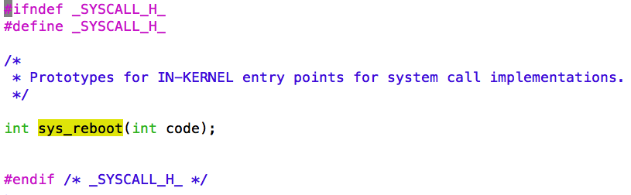
System Call: sys_reboot() In src/kern/include/syscall.h
Notes:
you have to implement the interface between user-mode programs ("userland") and the kernel. You will be provided part of the code needed for this assignment, and you are required to design and implement the missing pieces. Your job also includes implementation of the subsystem that keeps track of the multiple tasks you will have in the future. Importantly, you need to design data structures for "process" (Hint: look at kernel include files of your favorite operating system for suggestions,

Slide 13
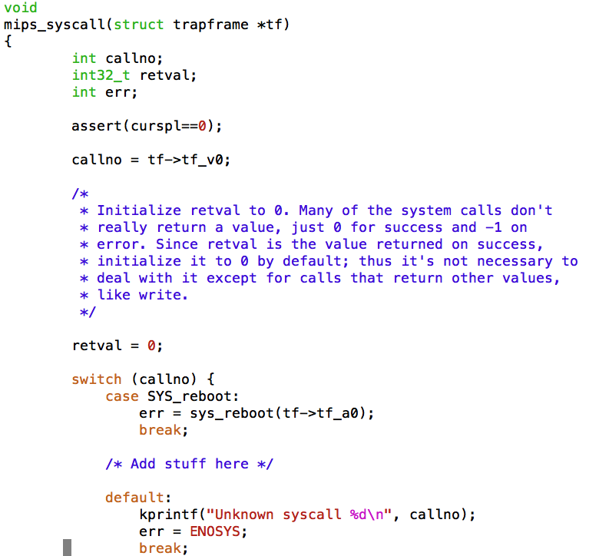
Exercise 3.
(3.1) Why curspl == 0?
(3.2) What is the tf->tf_v0 variable?
(3.3) Where is the tf->tf_a0 variable coming from?
Notes:
/*
* System call handler.
*
* A pointer to the trapframe created during exception entry (in
* exception.S) is passed in.
*
* The calling conventions for syscalls are as follows: Like ordinary
* function calls, the first 4 32-bit arguments are passed in the 4
* argument registers a0-a3. In addition, the system call number is
* passed in the v0 register.
*
* On successful return, the return value is passed back in the v0
* register, like an ordinary function call, and the a3 register is
* also set to 0 to indicate success.
*
* On an error return, the error code is passed back in the v0
* register, and the a3 register is set to 1 to indicate failure.
* (Userlevel code takes care of storing the error code in errno and
* returning the value -1 from the actual userlevel syscall function.
* See src/lib/libc/syscalls.S and related files.)
*
* Upon syscall return the program counter stored in the trapframe
* must be incremented by one instruction; otherwise the exception
* return code will restart the "syscall" instruction and the system
* call will repeat forever.
*
* Since none of the OS/161 system calls have more than 4 arguments,
* there should be no need to fetch additional arguments from the
* user-level stack.
*
* Watch out: if you make system calls that have 64-bit quantities as
* arguments, they will get passed in pairs of registers, and not
* necessarily in the way you expect. We recommend you don't do it.
* (In fact, we recommend you don't use 64-bit quantities at all. See
* arch/mips/include/types.h.)
*/

Slide 14
Which function calls mips_syscall()?
exception.S
mips_trap()
mips_syscall()
See cs161/kern/arch/mips/mips
Notes:
mips_trap() and mips_syscall() can be found in cs161/kern/arch/mips/mips

Slide 15
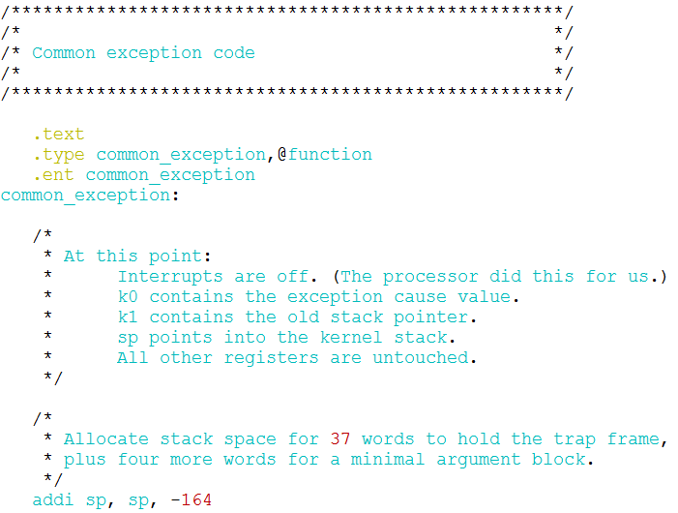
exception.S
Notes:
Leave 16 bytes in the bottom of its stack frame for writing back the value of a0-a3 (four arguments of caller).

Slide 16
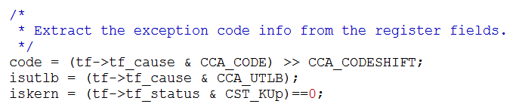
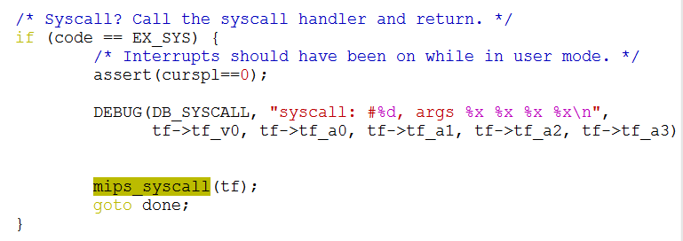
mips_trap() calls mips_syscall()
Notes:
Leave 16 bytes in the bottom of its stack frame for writing back the value of a0-a3 (four arguments of caller).

Slide 17
syscalls-mips.s in cs161/src/lib/libc
Machine-dependent code
To implement the user-level side of MIPS system calls.
It is copied to syscalls.S, and then the actual syscalls are appended as lines of the form
SYSCALL(symbol, number)
Notes:
syscalls.S: This file is created from syscalls-mips.S at compile time and is the actual file assembled into the C library. The actual names of the system calls are placed in this file using a script calledcallno-parse.sh that reads them from the kernel's header files. This avoids having to make a second list of the system calls. In a real system, typically each system call stub is placed in its own source file, to allow selectively linking them in. OS/161 puts them all together to simplify the makefiles.

Slide 18
syscalls-mips.s in cs161/src/lib/libc

Slide 19
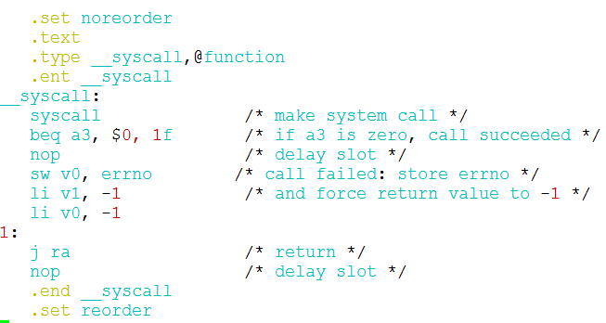
syscalls-mips.s in cs161/src/lib/libc (cont.)

Slide 20
syscall
A user program
Loads a system call code into register $v0
Loads the arguments into registers $a0, ..., $a3
System calls that return values
Put their result in register $v0

Slide 21
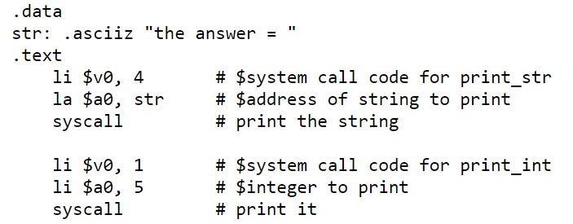
Syscall from a COMP4300 Project
A user program
Loads a system call code into register $v0
Loads the arguments into registers $a0, ..., $a3
System calls that return values
Put their result in register $v0

Slide 22
crt0.s in cs161/src/lib/crt0
MIPS assembly code: To receive control when a user-level program is started.
To call the user program's main()
To interface with execv()
execv() runs an executable file in the context of an existing process, replacing the previous executable.

Slide 23
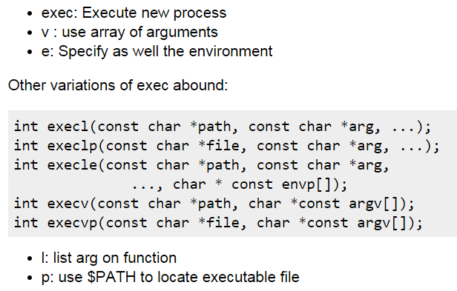
exec and its variations
Reference: http://stackoverflow.com/questions/926185/about-fork-and-execve-system-call
Courtesy of 0x6adb015

Slide 24
crt0.s in cs161/src/lib/crt0
crt0.s
Call main() in a user program
Call exit() when main() returns

Slide 25
crt0.S
Exercise 4 (Plickers): How does the main() function return a value back to controller crt0.s?
return
move s0, v0
jal main
move a0, s0
Notes:
Leave 16 bytes in the bottom of its stack frame for writing back the value of a0-a3 (four arguments of caller).

Slide 26
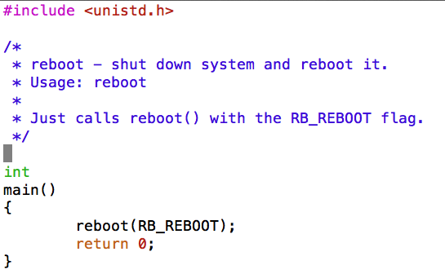
Exercise 5 (Plickers): Is this program an application or a part of the kernel? A. Application B. Part of Kernel

